Slide 1
Early Childhood Development

Slide 2

Learning Objectives
Understand child development and how it provides a foundation for future learning.
Consider types of development and key milestones for different age groups from birth - 8 years

Slide 3

What is early childhood?
Early Childhood is the period in a child’s life from Birth to 8 years of age.

Slide 4





Why is early childhood important?
When children are inﬂuenced by those around them. Early interactions are critical
Of remarkable growth
This is a period:
Where brain development is at its peak
Where we lay the foundations for life.
When children are inﬂuenced by the environment they are in

Slide 5
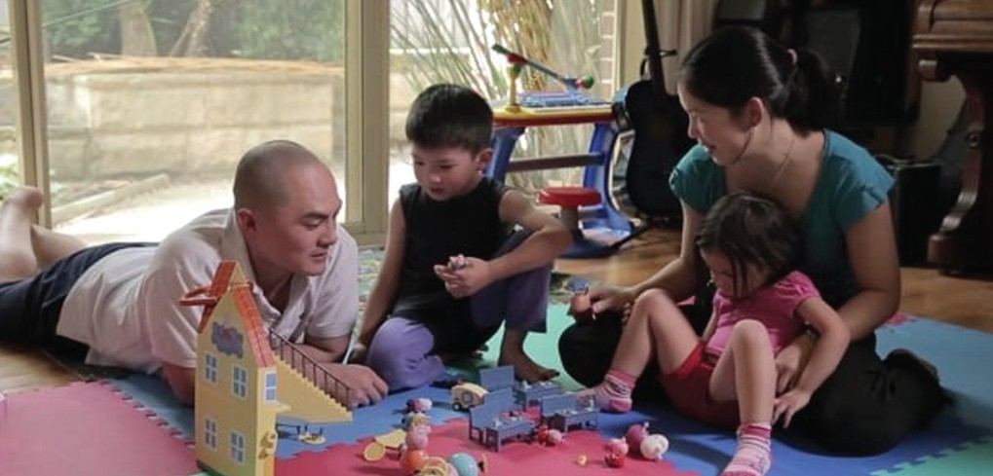
A quick overview…
Watch this video
was any of this a surprise to you? What did you learn?
What are your key pieces of information you take away from watching this?
https://raisingchildren.net.au/babies/videos/development-first-eight-years

Slide 6

Importance of getting it right!
experiences and development helps prepare children for life and educational experiences later on.
Healthy childhood
experiences, particularly the ﬁrst 5 years of life, impacts long–term social, cognitive, emotional, and physical development.
Unhealthy childhood

Slide 7

A quick overview…
Did you know the most your brain grows and develops is within the ﬁrst 5 years of life?
Did you know that as young as 2 months old researchers have found you start collecting information on the languages spoken around you?

Slide 8




Types of development
We will be looking at:
Physical Development
Cognitive Development
Language Development
Social And Emotional Development
health and being able to reach certain physical milestones- big and small (holding spoons, lifting their head for example)
develop new ways to think, communicate, and solve problems
learning linguistic skills and sounds
learn to interact with people, build conﬁdence

Slide 9
Developmental Milestones
Children are unique and will reach
developmental milestones at a diﬀerent rate.
Sometimes children are delayed and may not reach expected
milestones.
Early Intervention - The purpose of early intervention is to lessen the eﬀects of the disability or
delay or provide support and advice as required.
It is important that as parents, we monitor child development and if we are concerned, speak to our
child’s Paediatrician.
Sometimes delays are caused as a result of a child having special
educational needs, other times it is as a result of poor parenting/ environment.

Slide 10
Rate and Sequence
Different children = Different Growth Rates – all children are unique!
The rate that they develop will differ from child to child, but the sequence of development will not.
Children develop at different rates. If your child is not reaching some milestones, don’t panic! A child might meet some of these milestones a little earlier or a little later. Just like you and I , children are all different.

Slide 11
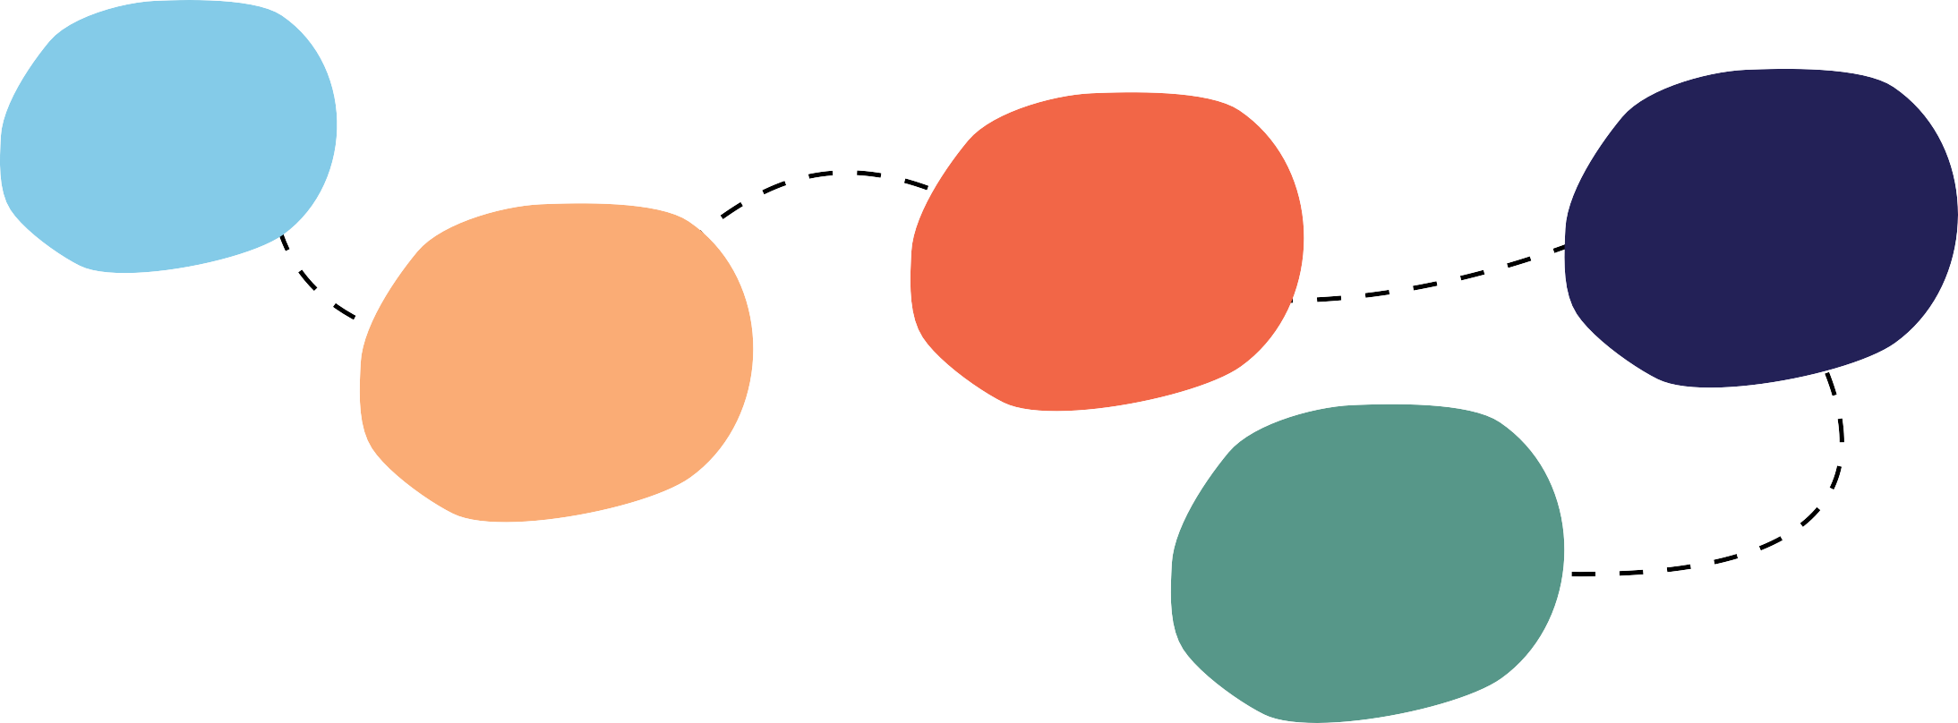
Birth – 1 year – Magic Moments
This is a time where interactions between infant and parents are magical!
Your child will move and turn their head when they hear your voice.
Tummy time will provide opportunities for interaction and for your child to strengthen their core muscles.
Your child will start to pull themselves up,
!crawl and be mobile
Your child will smile at you.
Your child will recognize you – and may show upset when you move away from
them.

Slide 12





2 year – Terrible Twos
Terrible twos can happen anywhere between 18-30 months of age
This age range is a time of substantial physical and cognitive growth, your child is starting to:
Talk
Walk
Have their own opinions
Learn about how they are feeling and their emotions
Start to learn about sharing and taking turns

Slide 13
3-5 years – the age of independence
This is the age to actively support independence:
Dress, feed and use the toilet themselves
Holds crayon/pencil etc. Between thumb and ﬁrst two ﬁngers
Dresses and undresses but still needs a little help
Exhibits hand preference
Hops, jumps and runs with ease
Imitates variety of shapes in drawing, e.g. Circles
Climbs steps with alternating feet
Independently cuts paper with scissors
Gallops and skips by leading with one foot
Toilet themselves
Transfers weight forward to throw ball
Feeds self with minimum spills
Attempts to catch ball with hands
Dresses/undresses with minimal assistance
Climbs playground equipment with increasing agility
Walks and runs more smoothly
Enjoys learning simple rhythm and movement routines

Slide 14
6- 8 years – Choices and Decisions
It is important that all children are given choices and empowered to make age and stage appropriate decisions. Children often need support in understanding how to make decisions – some decisions are harder than others to make.
Can you think of some ‘realistic’ choices that we could give 6- 8-year-old children?
Show your child how to think about decisions:
Determine what the options are
Consider every possibility
Consider the pros and cons of each option
Choose the best option
Re-evaluate after you see the results — decide whether or not it was a good choice and what you might do differently next time

Slide 15
Brief
This brief overview on Early Childhood Development (ECD) is intended to be the starting point for our future sessions, that will cover:
Learning Through Play: Encouraging Imagination and Creativity
Are You Happy and You Know It?
Learning Through Literacy
Making Math Fun
Managing Children's Behavior
The School – Home Partnership
Over the coming weeks we will be learning together and discussing the most important topic – our children.
Please feel free to ask questions or reach out for guidance and support as we go!

